Slide 1
ENR1 – Enrollment MODULE
Milestone 1, NSWI130, 2024
ENR 1 – Matyáš Černíček, Jan Čelovský, Šimon Jůza,
Jan Růžička, Vojtěch Snop, Rastislav Vojtuš

Slide 2
FEATURES - overview
Feature: 1. Enrolling to a new subject (Rastislav)
Feature: 2. Unenrolling from enrolled subject (Honza R.)
Feature: 3. Viewing enrolled subjects (Matyáš)
Feature: 4. Enrolling a student to a teacher's subject (Vojtěch)
Feature: 5. Notification of Invalid Enrollment (Šimon)
Feature: 6. Viewing subjects available for enrollment (Honza Č.)
1

Slide 3
RESPONSIBILITIES overview
Subject viewing and interaction responsibilities
Display information of available subjects for the student
Display information of all enrolled subjects for the student.
Ensure enrollment requests can be made
Display responsibilities
Display the list of subjects in which the student is enrolled.
Display a selector to choose a specific subject for unenrollment.
3

Slide 4
RESPONSIBILITIES overview
Enrollment processing responsibilities
Ensure enrollment requests are correctly processed
Ensure that the student is correctly enrolled to the selected subject
Ensure that all actions done are logged
Remove the subject from the students list of enrolled subjects.
Notify the student promptly of the outcome of the request.
4

Slide 5
RESPONSIBILITIES overview
Enrollment validation responsibilities
Validate student credentials, prerequisites
Validate availability of space for selected subject
Inform student of any issues that occurred during validation
Inform teacher of any issues that occurred during validation
Offer to place the student into an enrollment queue for the selected subject
Check if the unenrollment request meets specific criteria.
Check if there was some error during the unenrollment request.
5

Slide 6
RESPONSIBILITIES overview
Notification responsibilities
Notify the student if request was success or not
Send email notification to the student with the confirmation message and details about the enrollment.
Filtering responsibility
Filter available subjects for the student.
6

Slide 7
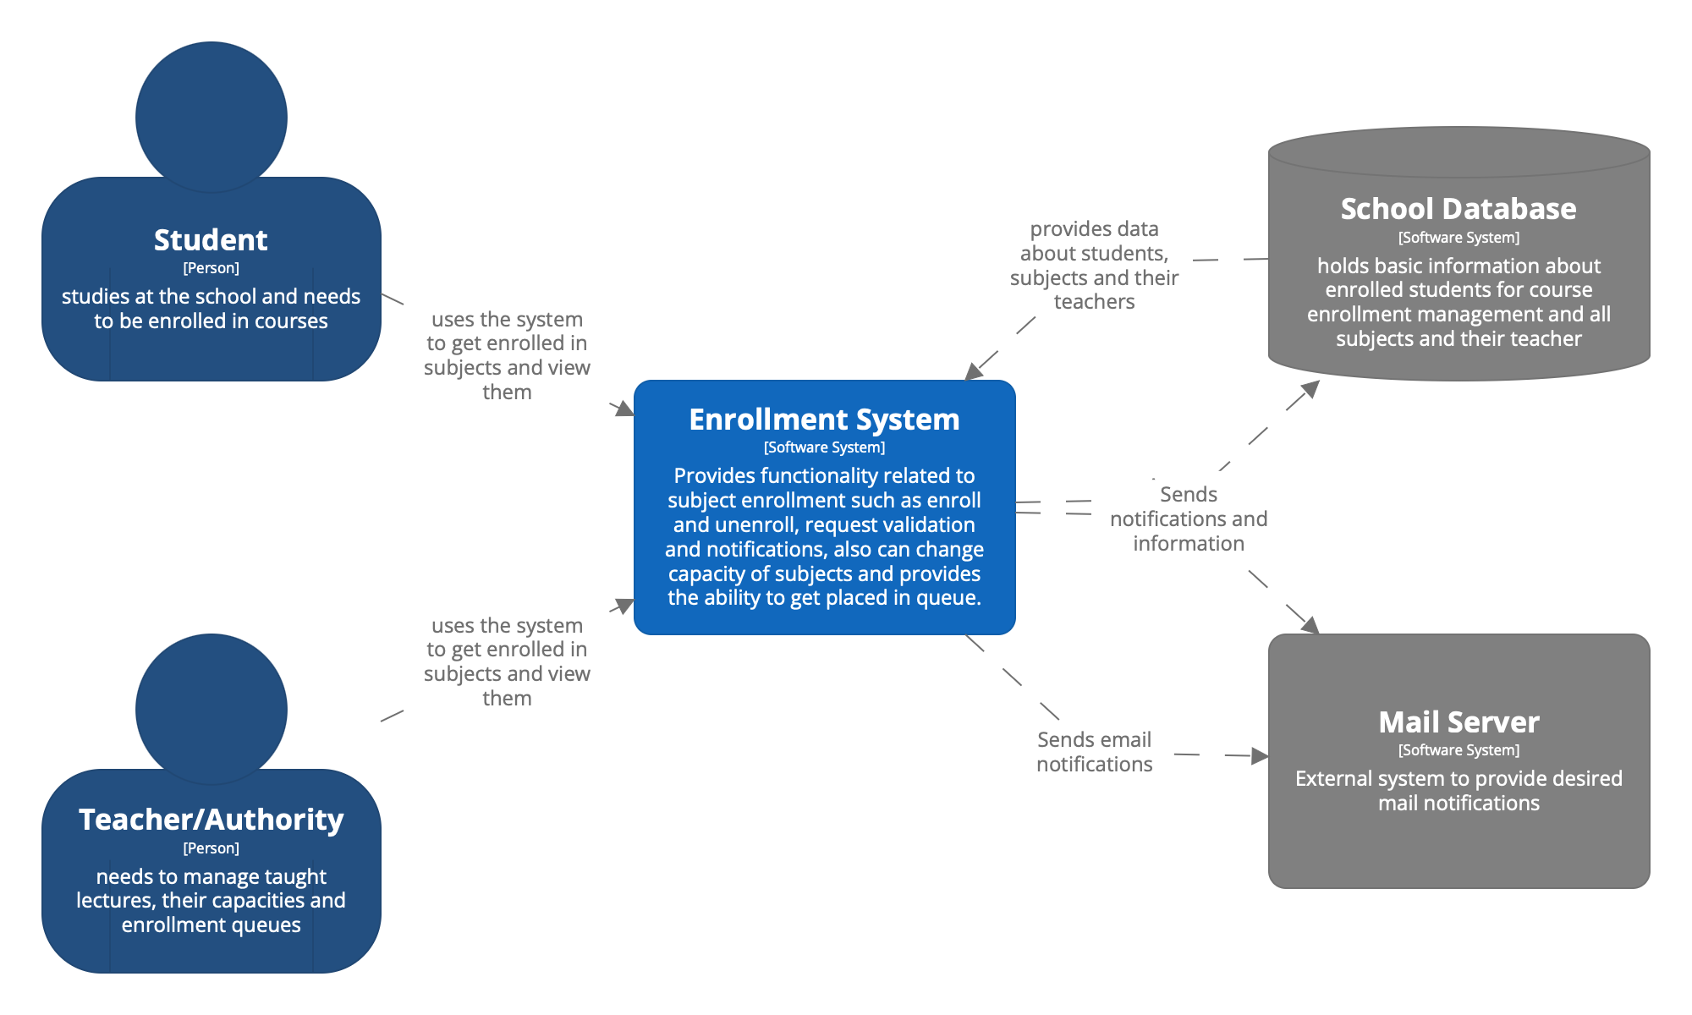
L1 DIAGRAM
7

Slide 8
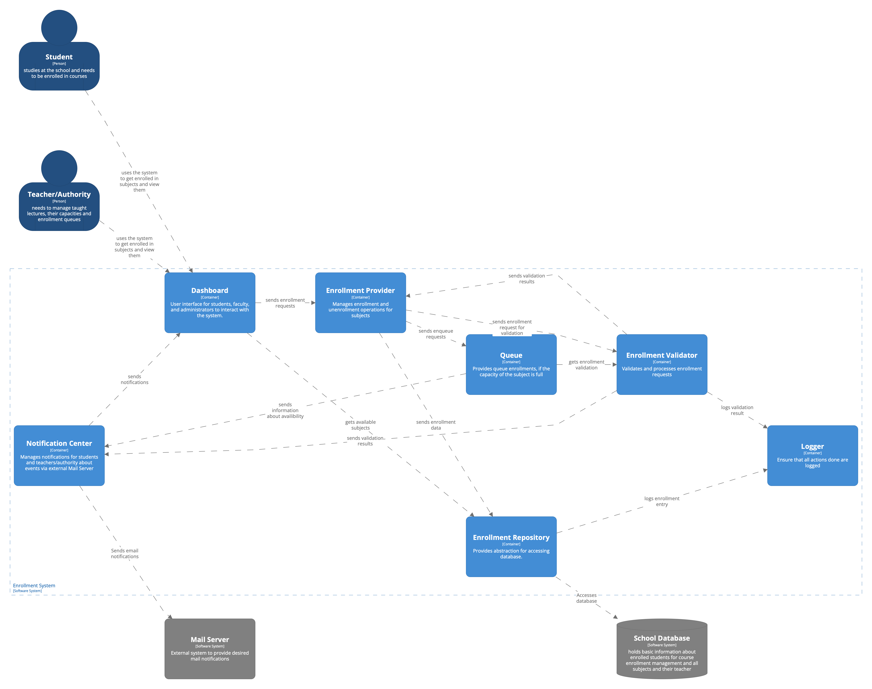
L2 DIAGRAM
Rastislav
Šimon
Vojtěch
Šimon
Jan R.
Jan Č.
Matyáš
8

Slide 9
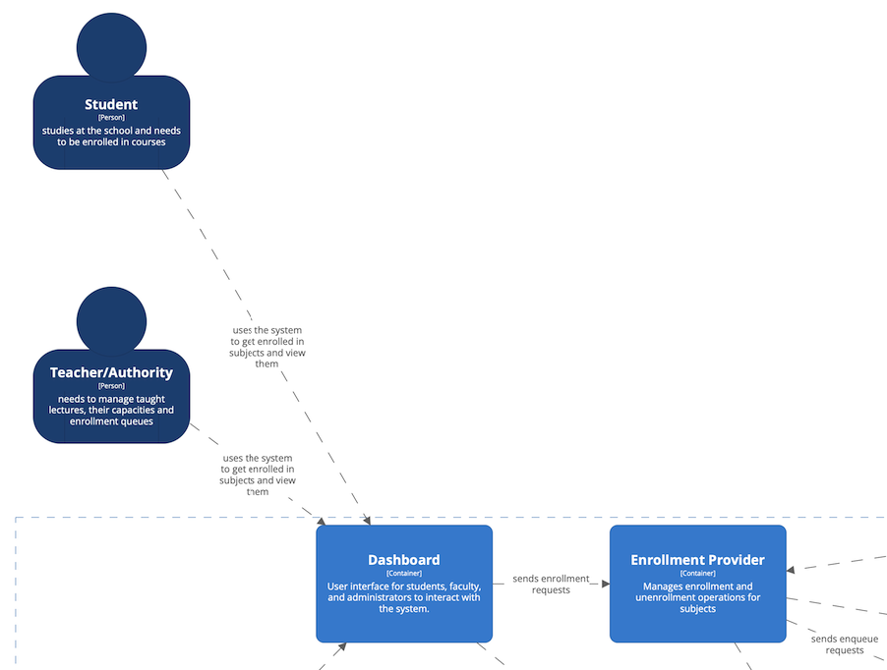
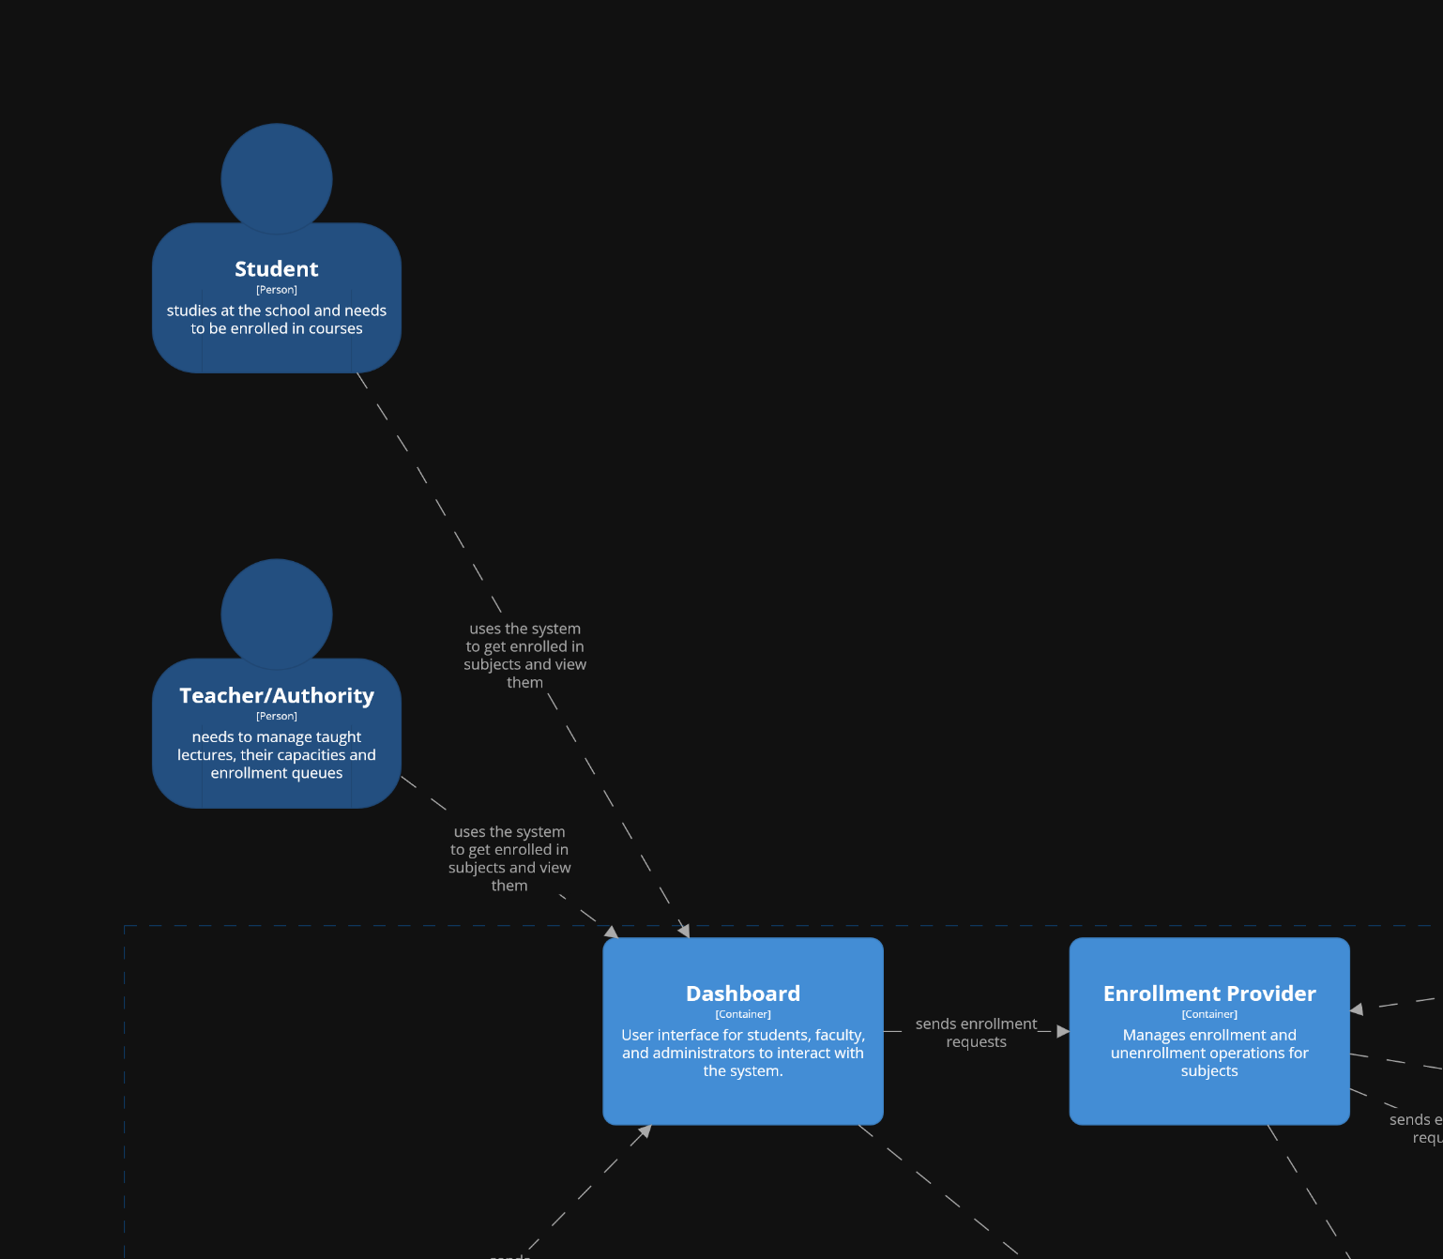
L2 DIAGRAM PT.1
9

Slide 10
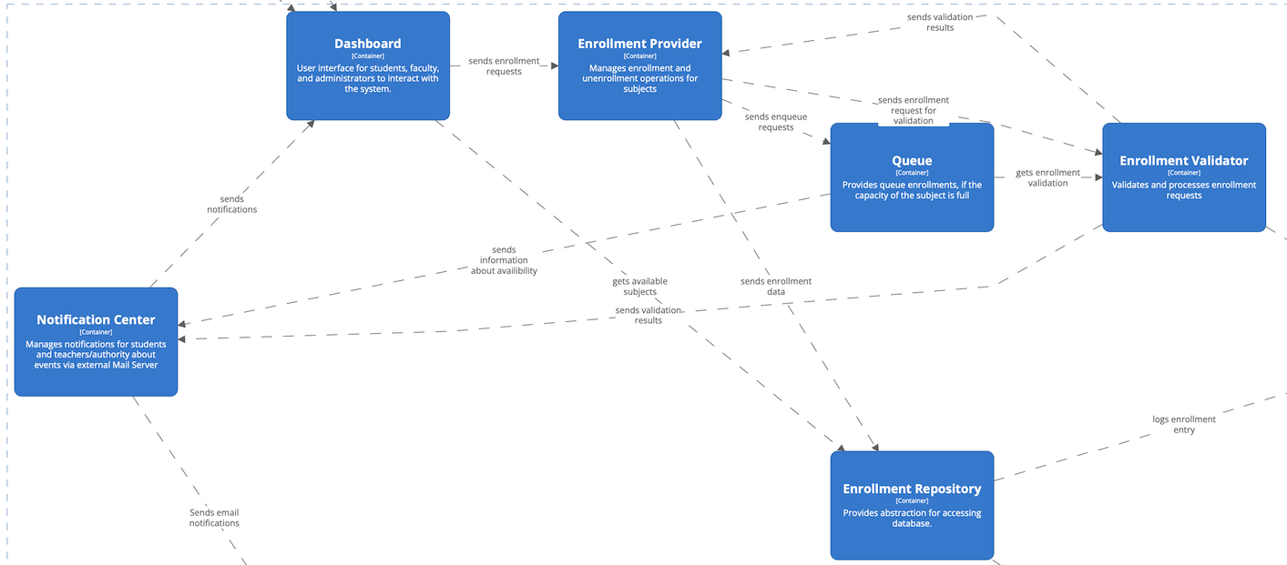
L2 DIAGRAM PT.2
10

Slide 11
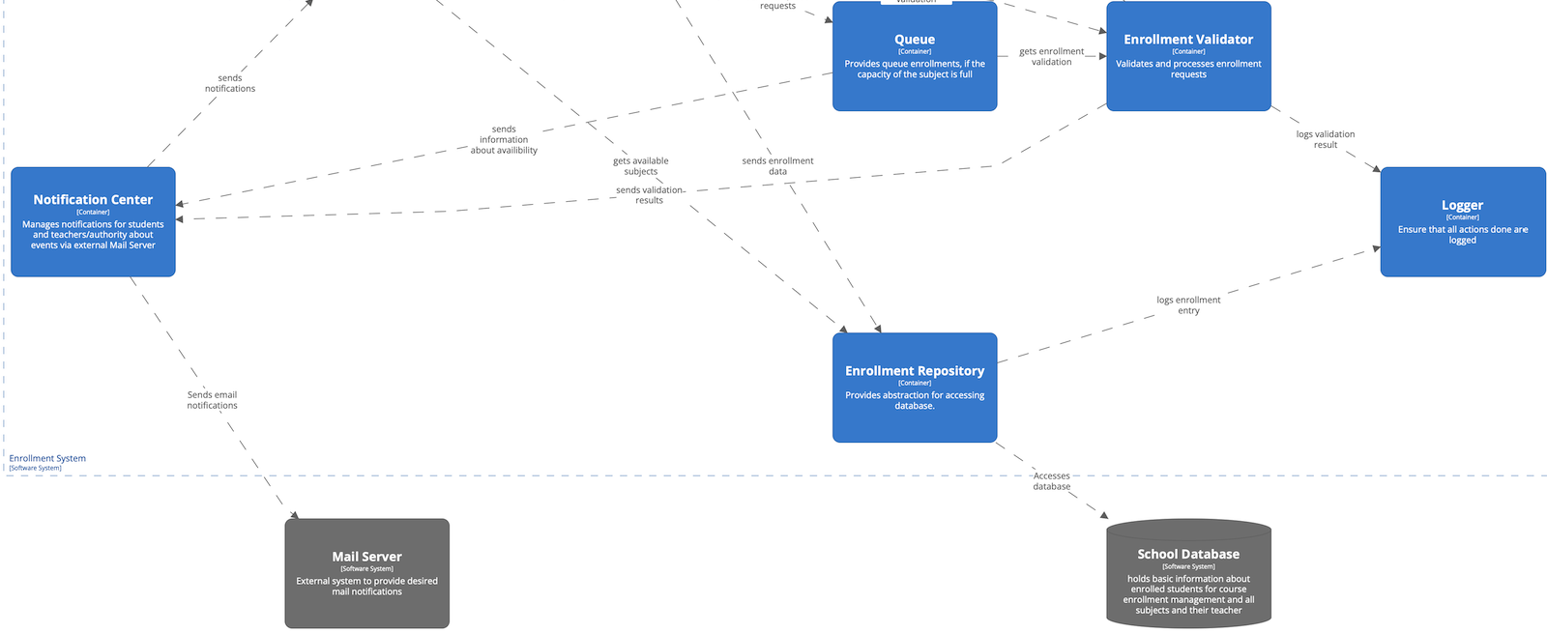
L2 DIAGRAM PT.3
11

Slide 12
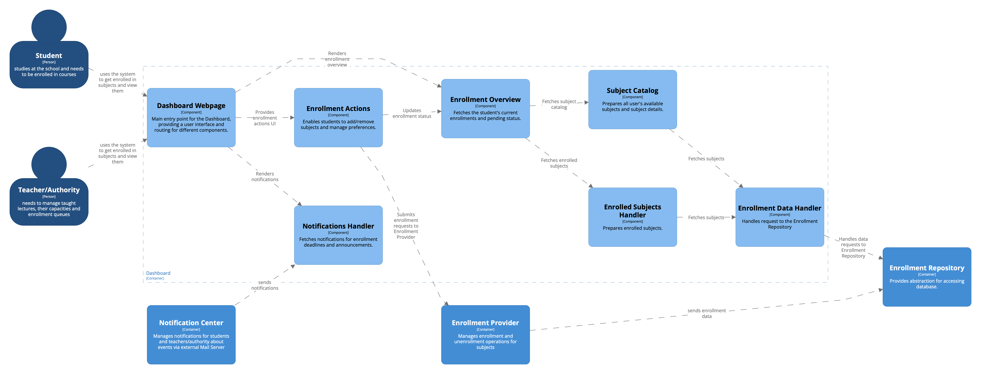
L3 DIAGRAM - DASHBOARD CONTAINER
Rastislav
12

Slide 13
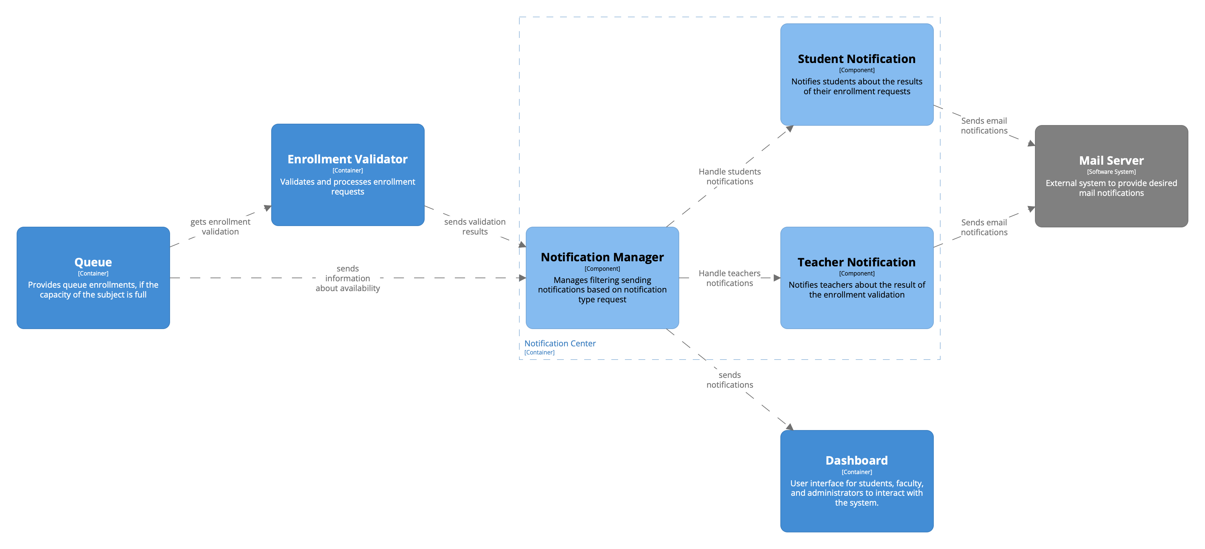
L3 DIAGRAM – notification center
Jan R.
13

Slide 14
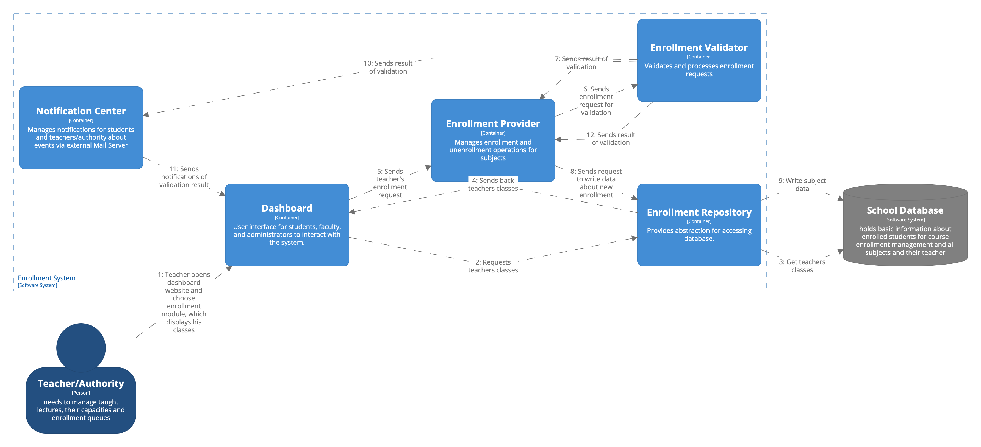
Dynamic diagram for feature „TEACHER enrolling IN a subject“
Vojta, Rastislav, Šimon
14

Slide 15
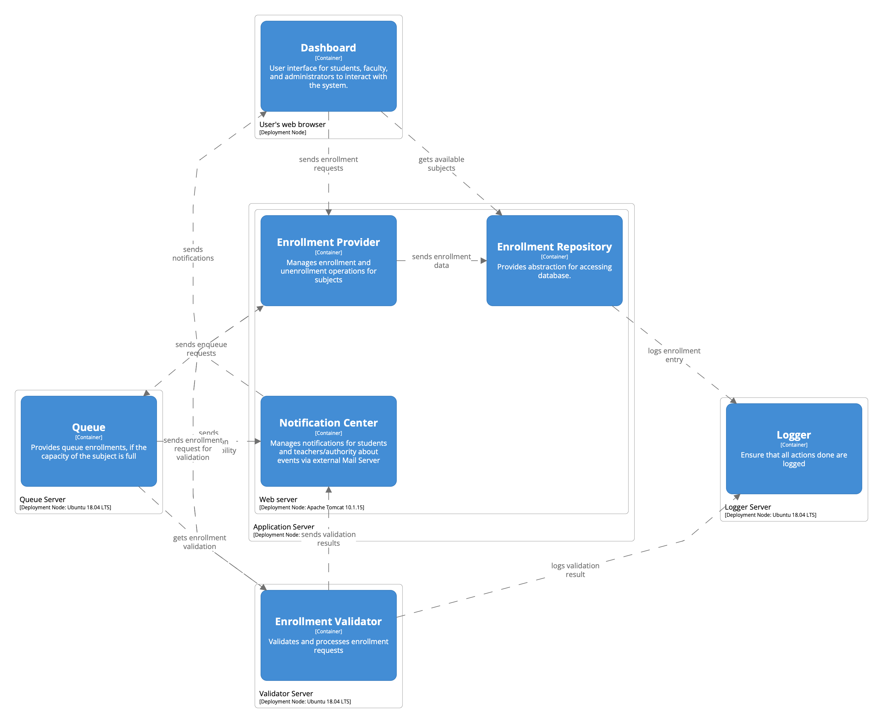
Deployment diagram
Vojta
15

Slide 16
Thank you for your attention!
15

